Slide 1



Slide 2
HackFS Jul 6 - Aug 6
Build the foundation for the decentralized web.
Virtual Hackathon by ETHGlobal and Protocol Labs

Slide 3
hacking 3bi
3 buttons interface to web3
File Social Payment
Click the first button and trigger the action
File

Slide 4
Ulvus
Kristian Erik Munk
HackFS Project july 2020​
Kmunk1975@gmail.com
https://github.com/ulvus/3-buttons-interface

Slide 6
3b utton interface
Contact
File on
ipfs
Microsoft windows
Chromium chrome/edge
Js

Slide 7
Hacking started
Have fun
Showcase
Check in
Submitting

Slide 8
A hackathon is a design sprint-like event; often, in which computer programmers and others involved in software development, including graphic designers, interface designers, project managers, domain experts, and others collaborate intensively on software projects.

Slide 10
Hackathons typically start with one or more presentations about the event, as well as about the specific subject, if any.
Then participants suggest ideas and form teams, based on individual interests and skills.
Then the main work of the hackathon begins, which can last anywhere from several hours to several days.

Slide 11
At the end of hackathons, there is usually a series of demonstrations in which each group presents their results.
To capture the great ideas often people post a video of the demonstrations, blog about results with screenshots and details, share links and progress on social media, suggest a place for open source code and generally make it possible for people to share, learn from and possibly build from the ideas generated and initial work completed.
There is a contest element as well, in which a panel of judges select the winning teams, and prizes are given. At many hackathons, the judges are made up of organisers and sponsors.

Slide 12
The decentralized web needs a decentralized filesystem.
The future is web3: a digital world that is censorship-resistant, decentralized, and trustless. A web where users control their own data and identity.
HackFS is an ETHGlobal hackathon focused on building the foundation for that world. We've partnered with Protocol Labs - the organization building Filecoin and IPFS - to run an event centered on dapps, web3, decentralized storage, and everything in between.

Slide 13
Hackfs

Slide 14
Kristian Erik Munk
Ulvus
Kmunk1975@gmail.com
Github.com/ulvus

Slide 15
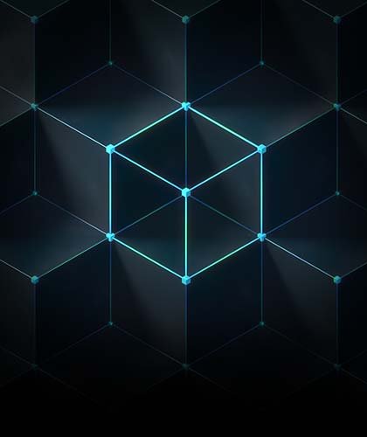

Is web addicted to the backbone?
Google: Our Edge Network is how we connect with ISPs to get traffic to and from users
Ipfs: powers the creation of diversely resilient networks that enable persistent availability

Slide 16
Deadline submitting
Project deadline 23:59 CEST on August 06th.
Encourage to submit full coding for Judging

